Slide 1
About Me
Ritesh Singh
Sun Certified java Professional
Oracle Certified Database Administrator
Certified Ethical Hacker
Certified EC-Council Instructor (CEI)

Slide 2
Selecting a MySQL Database Using USE Statement
o select a particular database to work with you issue the USE statement as follows:
USE database_name;
In this statement, following the USE keyword is the name of the database that you want to select.
Selecting a MySQL database via command line
The following steps demonstrate how to login to MySQL Server using the mysql program and select a database to work with:
First, log in to the MySQL using a particular user e.g., root:

Slide 3
>mysql -u root -p
In this command, we have specified the user root with -u flag and then used the -p flag. MySQL prompted for the password of the user. You need to type the password and press Enter to log in.
Second, issue the USE command to select a database, for example classicmodels:
mysql> use classicmodels;
Database changed
In this command, we selected the classsicmodels database. If the database exists, MySQL issued the message “Database changed“.

Slide 4
In case the database does not exist, MySQL issued the following error:
mysql> use abc;
ERROR 1049 (42000): Unknown database 'abc'
Third, you can get the name of the currently connected database by using the database() function:
mysql> select database();
+---------------+
| database() |
+---------------+
| classicmodels |
+---------------+
1 row in set (0.00 sec)
Finally, to select another database, you just need to issue the USE statement and the new database name, for example:
mysql> use tempdb;
Database changed

Slide 5
Selecting a database when you login
If you know which database you want to work with before you log in, you can use the -D flag to specify it as follows:
>mysql -u root -D classicmodels -p
In this command, we specified the database name classicmodels following the -D flag. Because we used -p flag, MySQL prompted for the password of the root user. You just need to provide the password and press Enter to log in.

Slide 6
Once logged in, you can check the current database:
> select database();
+---------------+
| database() |
+---------------+
| classicmodels |
+---------------+
1 row in set (0.00 sec)

Slide 7
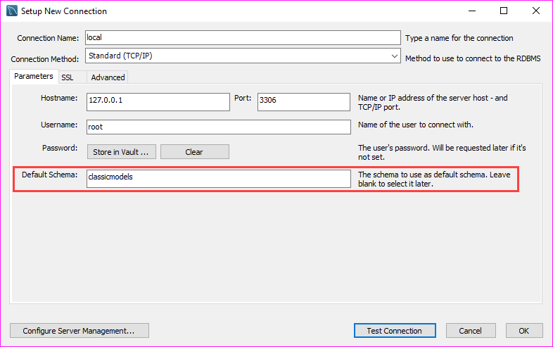
Selecting a database in MySQL Workbench
If you connect to a MySQL Server via the MySQL Workbench application, you can select a database when you create the database connection as shown in the screenshot below:

Slide 8
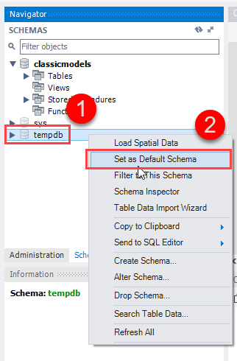
Once you logged in, you can select another database by issuing the USE statement or use the Set As Default Schema feature provided by MySQL Workbench.

